Slide 1
If I perish, I perish
Part Two
28/8/2016
Grace Liew
Notes:
Overview
Today, we are going to continue our series on “If I perish, I perish”- the famous words that Esther said when she began to understand the destiny that God had called her to and responded by resolving in her heart that no matter what happens to her, she will lay down her life.
The topic of dying is not a popular topic. It’s funny because with God, what we think is opposite to Heaven’s realities. Jesus told His disciples – If you want to find life, you must lose it to find it. In essence, when we learn to give our lives (fully give it), we learn what it truly means to live.
Let’s look at our key text, John 12 again.
John 12 tells us that unless a grain of wheat falls to the earth to die, it will not live again. Unless we die, we can never experience the resurrection power of Jesus working in our lives. His (resurrection) power is strongest in us when we willingly give ourselves over to Him in full surrender.

Slide 2
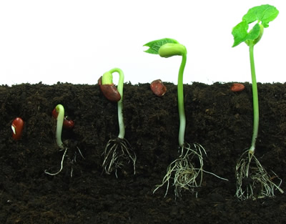
John 12:24-26 (AMP)
"I assure you and most solemnly say to you, unless a grain of wheat falls into the earth and dies, it remains alone [just one grain, never more].
But if it dies, it produces much grain and yields a harvest.

Slide 3
John 12:24-26 (AMP)
The one who loves his life
[eventually] loses it [through death],
but the one who hates his life in this world [and is concerned with pleasing God]
will keep it for life eternal.

Slide 4
John 12:24-26 (AMP)
If anyone serves Me, he must [continue to faithfully] follow Me
[without hesitation, holding steadfastly to Me, conforming to My example in living and, if need be, suffering or perhaps dying because of faith in Me];
and wherever I am [in heaven’s glory], there will My servant be also. If anyone serves Me, the Father will honour him.
Notes:
In order to faithfully follow Jesus, we need to hold steadfastly. We will talk about this quality of steadfastness later on.

Slide 5
Recap
What does it mean to die?
  Present our bodies
  Present our members
  Present our minds
The enemy to complete surrender
  Our heart attitude
  “Other things” that choke us (thorny ground)
  Our own souls
Living a resurrected life!
Notes:
To recap, we covered this last time. This week, we will look deeper into the barriers or the enemy to complete surrender (our ability to give our lives to God).

Slide 6
The Soul
Consists of mind, will and emotions
In Psalms 42:5 (AMP)
  “Why are you in despair, O my soul? And why have you become restless and disturbed within me? Hope in God and wait expectantly for Him, for I shall again praise Him for the help of His presence..”
David speaks to his emotions and harnesses his will to praise God
Notes:
In our John G Lake lessons, we learned that our souls consist of three parts: Mind, Will and Emotions. This is the part that needs to be constantly sanctified while we are here on earth. This is why Romans 12: 1-2 talks about re-presenting ourselves to God as a living sacrifice.
In Psalms, we see that David is speaking to his soul. He doesn’t feel like praising God. He feels down, discouraged, disturbed. But he speaks to his soul (his emotions). David often encourages himself and strengthens himself in the Lord this way. He speaks to his soul and tells his feelings to get in line. He uses his will to praise God.
If we don’t present our minds to be renewed, it becomes an enemy against us and stops us from moving forward in the things of God.

Slide 7
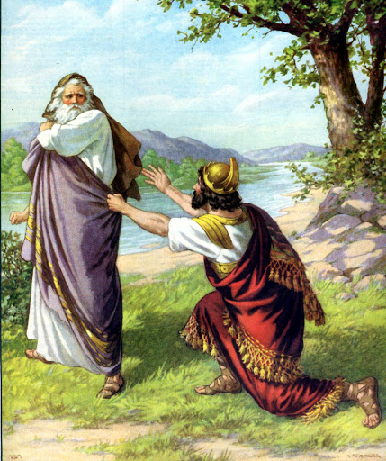
The enemy we fail to conquer, will conquer you
Saul failed to obey God’s instructions (1 Sam 15)
Prov 3:5 Trust in the Lord with all your heart. Lean not on your own understanding.
Because of Saul’s disobedience, generations later had to fight the battle he could’ve won.
Notes:
Saul experienced this when instead of trusting God with all his heart, he used his mind. Prov 3:5 and rationalised God’s instructions to him.
Because Saul failed to obey, he failed to conquer the enemy of his own soul (his mind). And successive generations had to fight the battle that he could’ve won. And that God had intended for him to win.
God had intended for Saul to conquer the Amalekites but Saul never lived to the full potential of all that God called him to be. How would you feel if God said those words about you “I greatly regret”. Saul had leaned on his own understanding. He allows his mind to get in the way of what God said. And it wasn’t just him who lived through the consequences of his actions.

Slide 8
Failure to conquer enemies now will jeopardize future generations
Enemies that are not conquered in our lifetime will linger to conquer future generations.
In Psalms 78:9, the children of Ephraim although they were armed and ready for war turned back in the day of battle.
They never overcame their enemies!
Notes:
Future generations suffer from this generations failures. The converse is also true – future generations prosper from this generation’s successes.
In Psalm 78:9, the Children of Ephraim were armed and ready but they turned back!! They never overcame their enemies. This is sad because in the verses preceding, it talks about ensuring that testimonies are passed onto the next and future generations so that they will follow God and not forget Him. They obviously did not do that.

Slide 9
Saul | Mordecai
Son of Kish, Benjamite (1 Sam 14:51) | Son of Kish, Benjamite (Esth 2:5)
Enemy of the day: Amalekites Saul instructed to utterly destroy the Amalekites. | Enemy of the day: Haman, the Agagite
Action: Saul fails to follow instructions and spares King Agag’s life | Action: Prayer and fasting Queen Esther exposes Haman
Immediate consequence: Kingship and Kingdom given away (1 Sam 13:13-14) Latent consequence: Kish carried into captivity (Esth 2:6) | Consequence: The Jews conquered their enemies (Esth 9:5)
Notes:
So we see the consequence of Saul’s actions – He failed to conquer the enemy of his day. And his failure caused future generations to suffer.
In Esther 2:6, we see that the family of Kish was brought into captivity. Which is why we have Mordecai in Persia. He is a descendant of Saul (of the family of Kish). And the enemy of his day was Haman. A formidable man who had the respect and backing of the King. Despite the oppression and evil law introduced intended to annihilate the Jewish race, Mordecai was able to overcome the enemy. Through great discernment, Mordecai initiates (together with Esther) city-wide prayer and fasting. This ended well – Mordecai overcame.
But it could have been avoided had Saul not turned his heart away, and leaned on his own understanding.
Our enemy may not be a person. It can be a mindset, an attitude or a behavioural pattern. These need to be overcome now in our lifetime so that future generations will not have the same issues (just like Abraham lied about Sarah being his sister. We see that Isaac and Jacob had similar issues. It set a negative pattern and stronghold in the family).
We need to confront issues head on now so that it won’t be a problem later.
Illustration: Putting your head in the sand like an ostrich doesn’t make the problem go away. The problem is still there and while your head is in the sand, the problem may get bigger!

Slide 10
Conquering the enemy to surrender
1. Repent
  Agree with God
2. Re-present ourselves back to God
  Allow God to renew, transform, change and reset us
3. Return back to first love
  Align with God
4. Remain steadfast
  Anchored in hope and faith
Notes:
So how do we conquer the enemy of ourselves? This links back to Part One. We need to come back to God and re-present ourselves back to Him. And when we have done that, stay steadfast (remember John 12. If anyone wants to follow Jesus, we must hold steadfastly).
The first step is the hardest. But if you take a step forward and follow it up with another step, you’ll soon find that you’re walking with Jesus. And soon, you are running the race again as God intended.

Slide 11
For you have need of endurance…
Heb 10:35-11:1
Therefore do not cast away your confidence, which has great reward. For you have need of endurance, so that after you have done the will of God, you may receive the promise: “For yet a little while, And He who is coming will come and will not tarry.
Now the just shall live by faith; But if anyone draws back, My soul has no pleasure in him.”
But we are not of those who draw back to perdition, but of those who believe to the saving of the soul.
Now faith is the substance of things hoped for, the evidence of things not seen.
Notes:
Now that we are running the race, we need to remember one thing. We need endurance. After we have done the will of God (Rom 12:1-2 when we present ourselves to God and allow Him to renew our minds, we prove what is the will of God), we can receive the promise.
It is a life of faith. Don’t draw back but move forward. Faith is the substance of things hoped for, the evidence of things not seen with our natural eyes. But with the eyes of our hearts.
Endurance is only mentioned one other time and also in the book of Hebrews. Heb 12:1 Let us run with endurance. You may have the word "patience" in your bibles instead of endurance. The Greek word is Hupomone which means
Cheerful, hopeful endurance or constancy. Steadfastness –the characteristic of a man who is not swerved from his deliberate purpose and his loyalty to faith and piety by even his greatest trials and sufferings. Patient enduring, sustaining and perseverance.
Steadfast - Daniel was steadfast (unchangeable-ness during changeable times). Despite evil, jealous satraps plotting his downfall, Daniel remained steadfast and kept his daily habit of praying in open. In Psalms 51, David prayed for God to renew a steadfast spirit within him. In other Psalms, David declares that his heart is steadfast – it was a decision of his will to sing and praise God despite his circumstances. The Lord is my rock and my defense, I shall not be moved. Because my life is on Jesus the rock, I cannot be moved. I cannot be affected, I cannot be shaken, I cannot be disturbed or distracted.

Slide 12
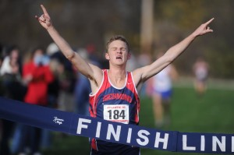
Don’t just run the race.
Run the race to win
Notes:
Don’t just run the race or sit in the stands watching.
Run the race that God has given you. Run it to win it. Live to the full potential of all that God has intended for you.

